Slide 1




NEXT GEN EMPLOYABILITY PROGRAM
Creating a future-ready workforce
Team Members
College Name
Student Name : Leena Bency A
Student ID : au311121104032
Loyola – ICAM College of Engineering and Technology

Slide 2

CAPSTONE PROJECT SHOWCASE
Project Title
Music Application using Django Framework-Leena Bency.A-(4032)_LICET
Abstract | Problem Statement | Project Overview | Proposed Solution | Technology Used | Modelling & Results | Conclusion

Slide 3
Abstract
MusicBeats is a dynamic music application built on the Python Django framework, aiming to revolutionize the way users engage with music.
With features like user authentication, personalized playlists, and advanced recommendation algorithms, MusicBeats offers a tailored music experience.
Leveraging Django's backend capabilities and frontend technologies, MusicBeats ensures seamless navigation and interaction. Machine learning algorithms enhance the recommendation system, providing users with curated playlists based on their preferences.
MusicBeats aims to redefine music consumption in the digital age by delivering a personalized and immersive musical journey.
Source :

Slide 4
Problem Statement
Existing music applications lack seamless integration, intuitive interfaces, and personalized experiences, leaving users struggling to discover music aligned with their tastes.
To address this, MusicBeats aims to develop a Python Django-based music application. It will focus on efficient data management, secure authentication, dynamic frontend interactions, and accurate recommendations.
By doing so, MusicBeats seeks to redefine music consumption, providing users with a seamless and personalized music exploration platform.
Source :

Slide 5
Project Overview
MusicBeats is a Python Django-based music application offering a seamless and personalized music experience.
With user authentication, personalized playlists, and advanced recommendation algorithms, it revolutionizes music consumption.
Leveraging Django's backend and frontend technologies, MusicBeats delivers smooth navigation and interaction.
Through machine learning, it tailors music suggestions, redefining how users engage with music in the digital era.
Source :

Slide 6
Proposed Solution
.
MusicBeats will offer secure user authentication and personalized playlists through Django's authentication framework and database capabilities.
It will utilize machine learning for personalized music recommendations and AJAX for dynamic frontend interactions.
Integration with external APIs will enrich the music catalog. Thorough testing and deployment on scalable platforms will ensure reliability and performance.
This comprehensive solution aims to redefine music consumption, providing users with a seamless and personalized music exploration platform.
Source :

Slide 7


Technology Used
Front-end
Back-end
Source :

Slide 8
Modelling & Results
Modelling:
User Authentication
Music Data Management
Personalized Playlist
Recommendation Engine
Results:
Secure User Authentication
Efficient Music Data Handling
User-Friendly Playlist Management
Personalized Music Recommendations
Intuitive User Interface
Source :

Slide 9
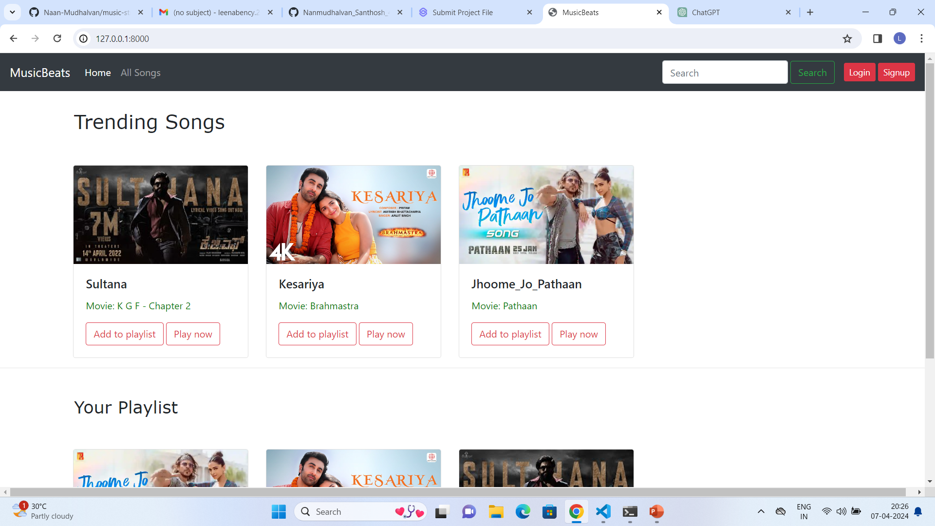
Homepage

Slide 10
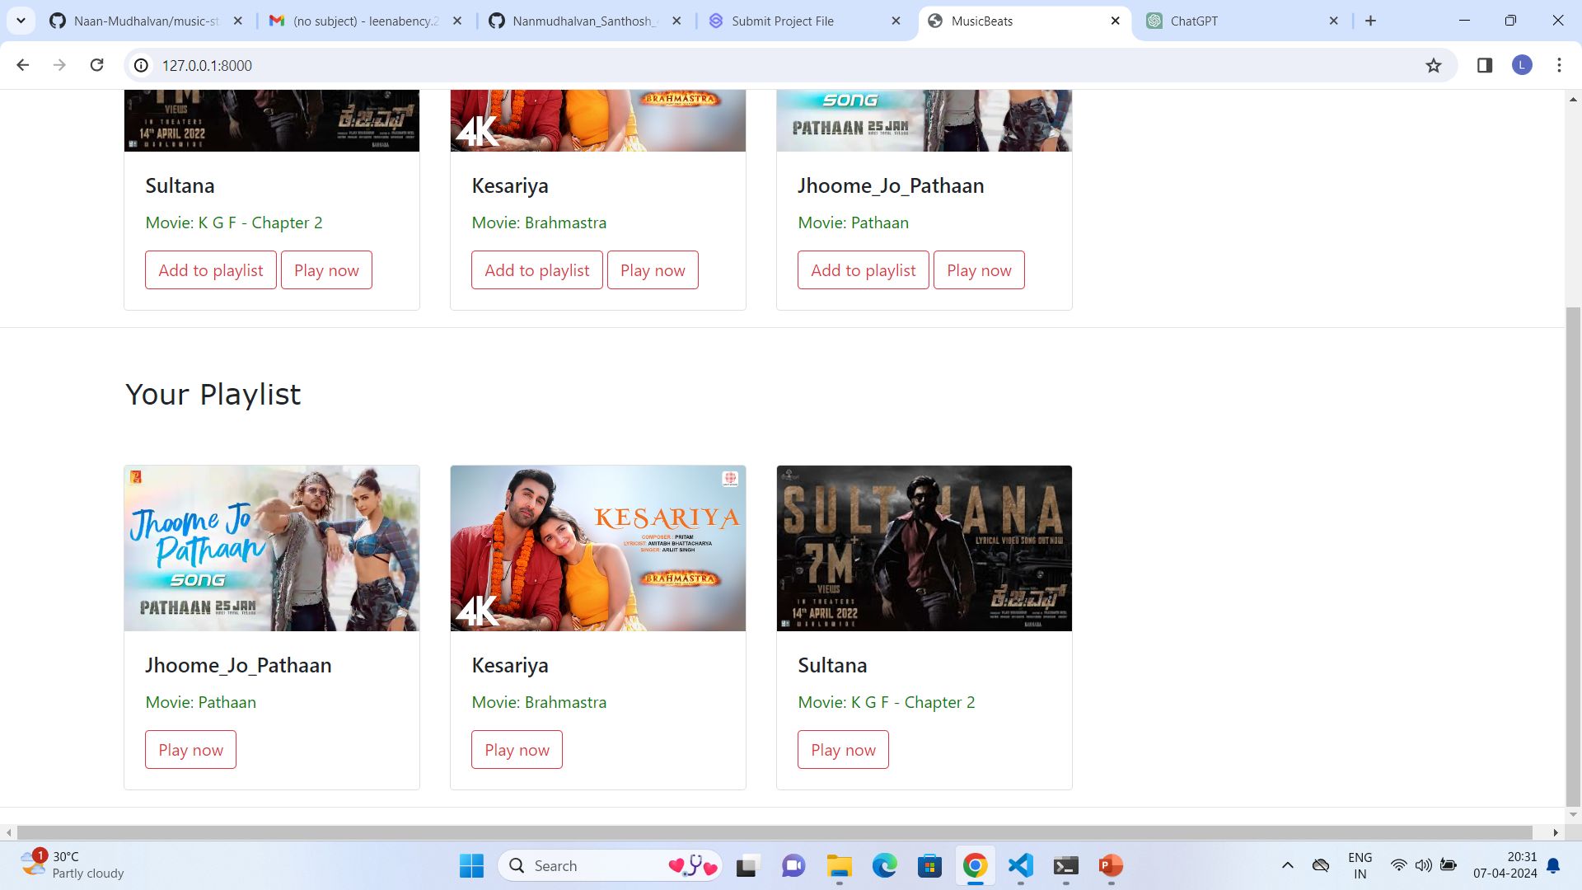
Source :

Slide 11
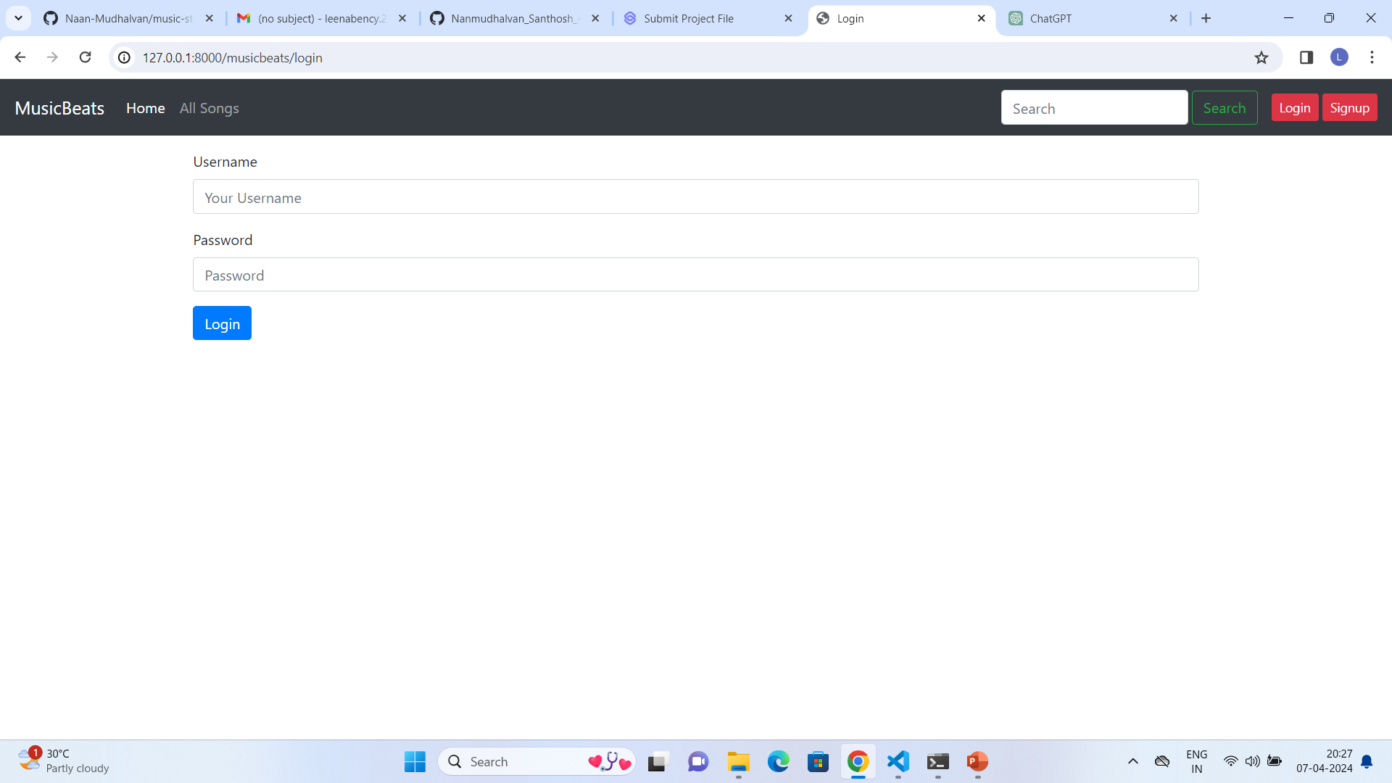
Login Page

Slide 12
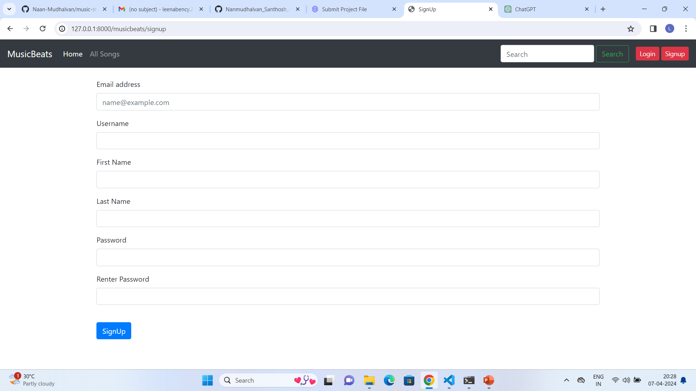
Sign Up Page

Slide 13
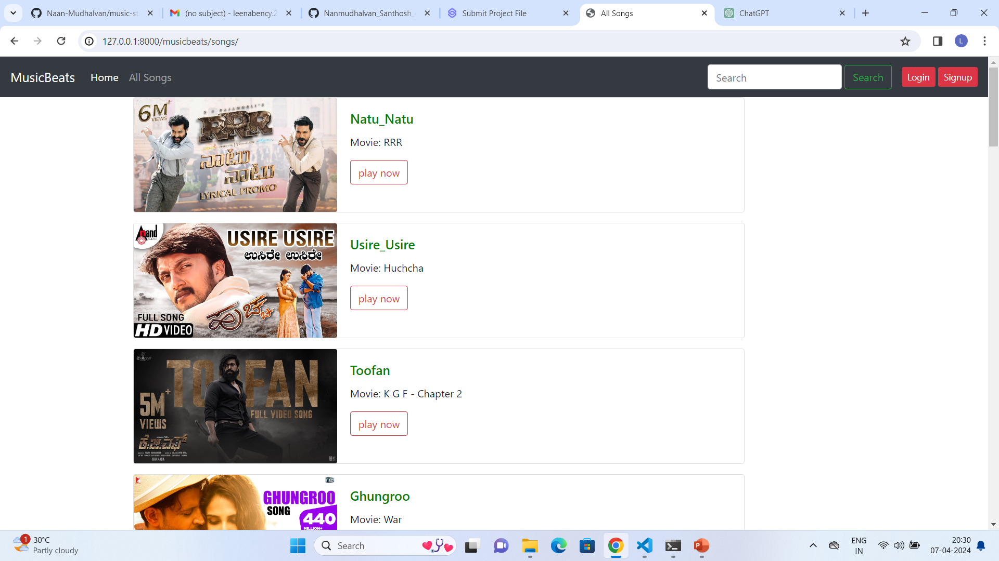
All Songs Page

Slide 14
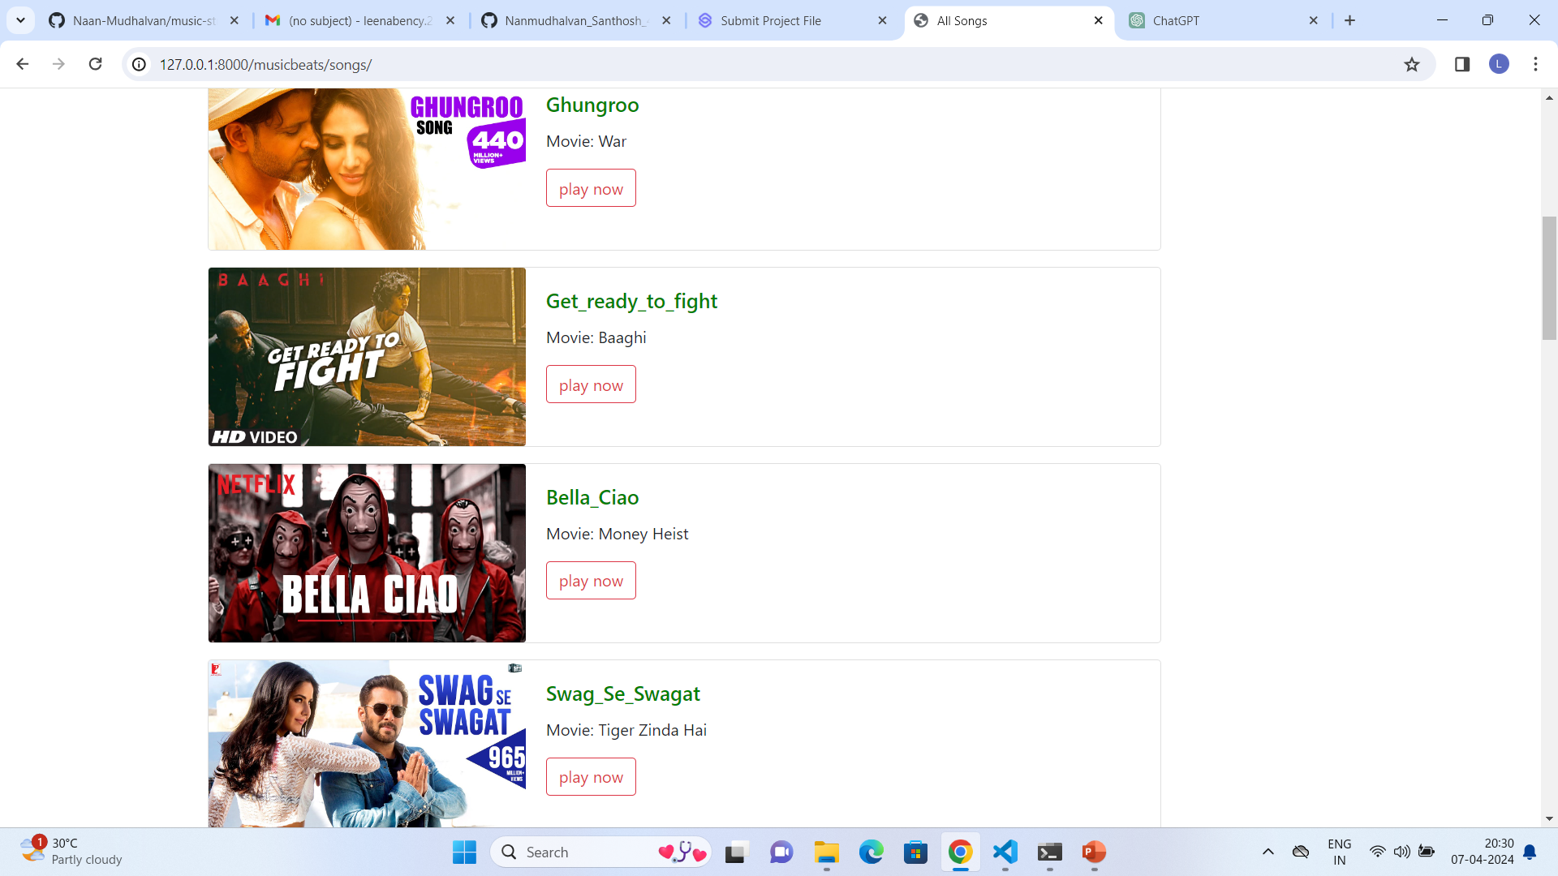
Source :

Slide 15
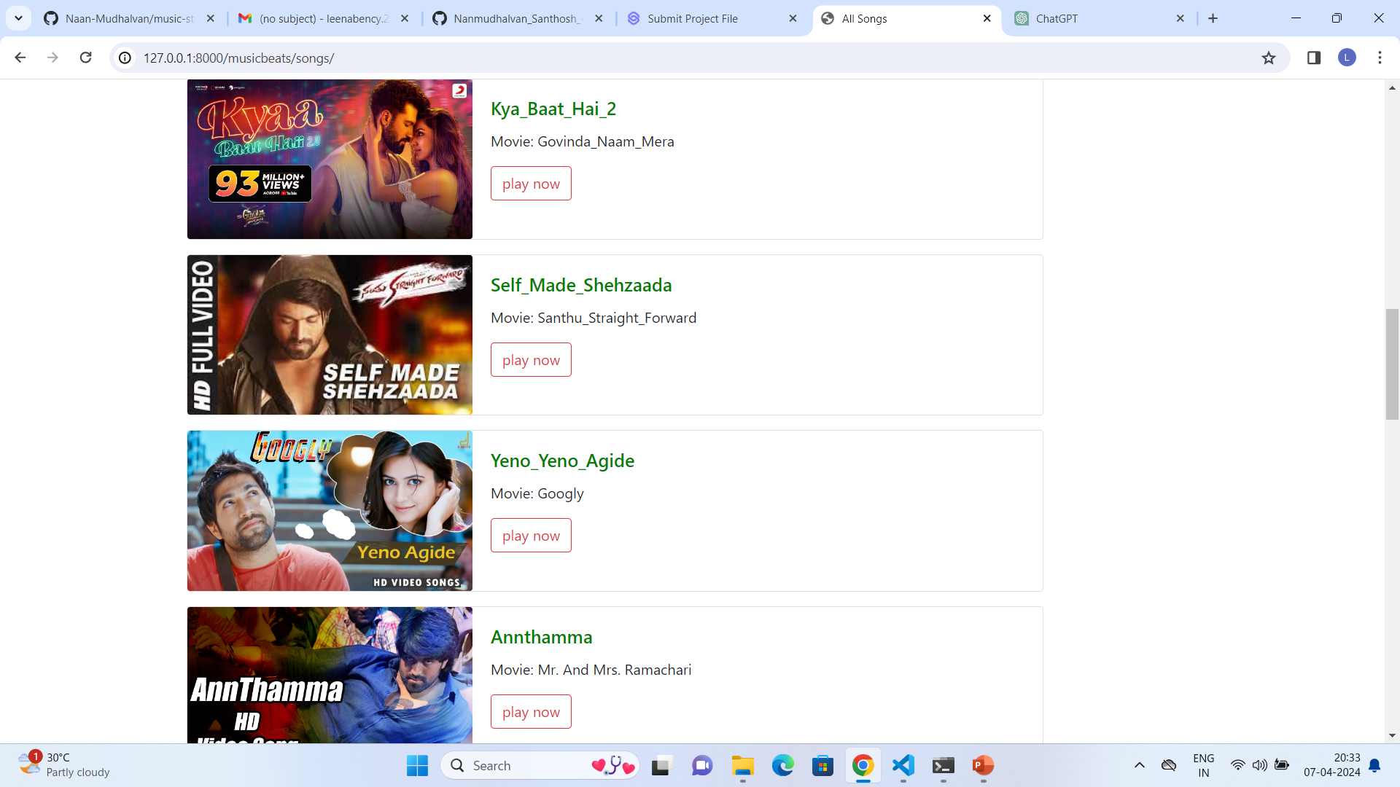

Slide 16
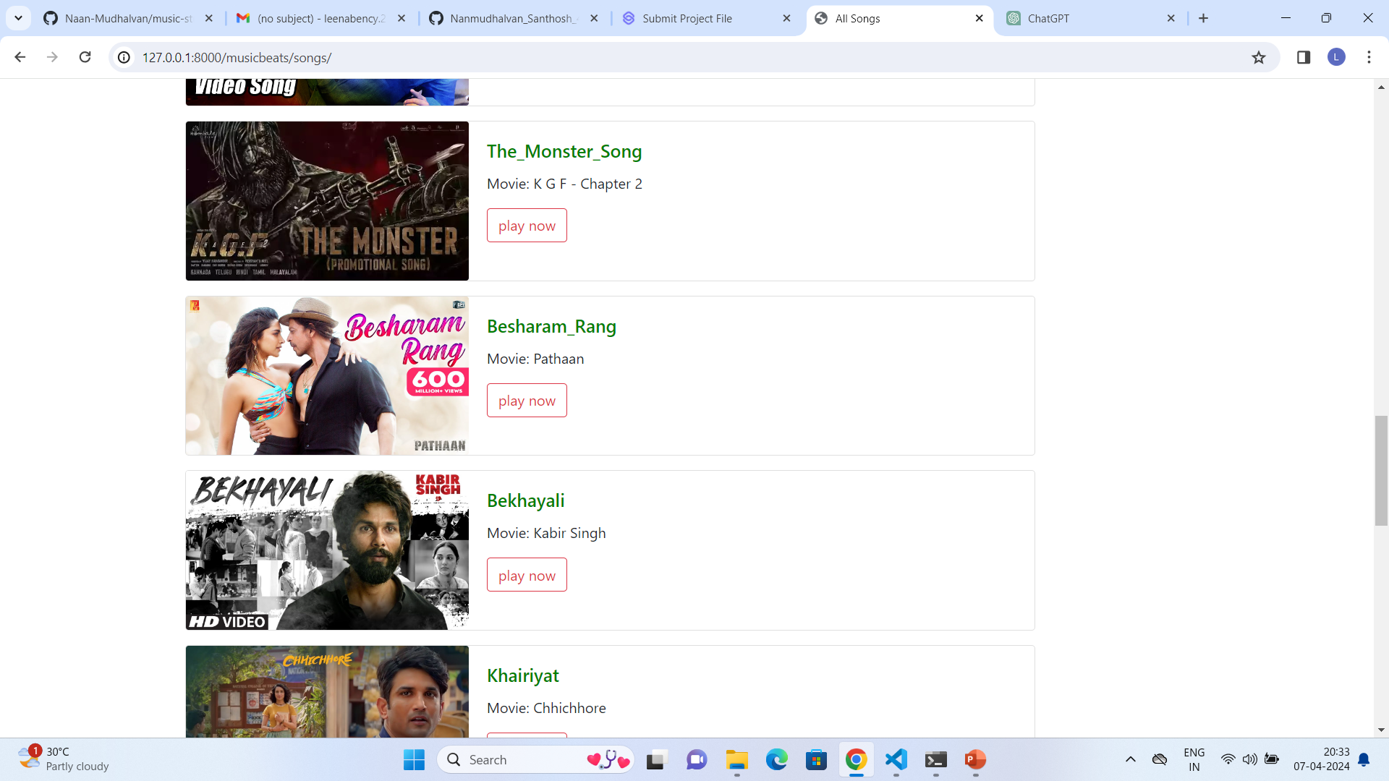

Slide 17
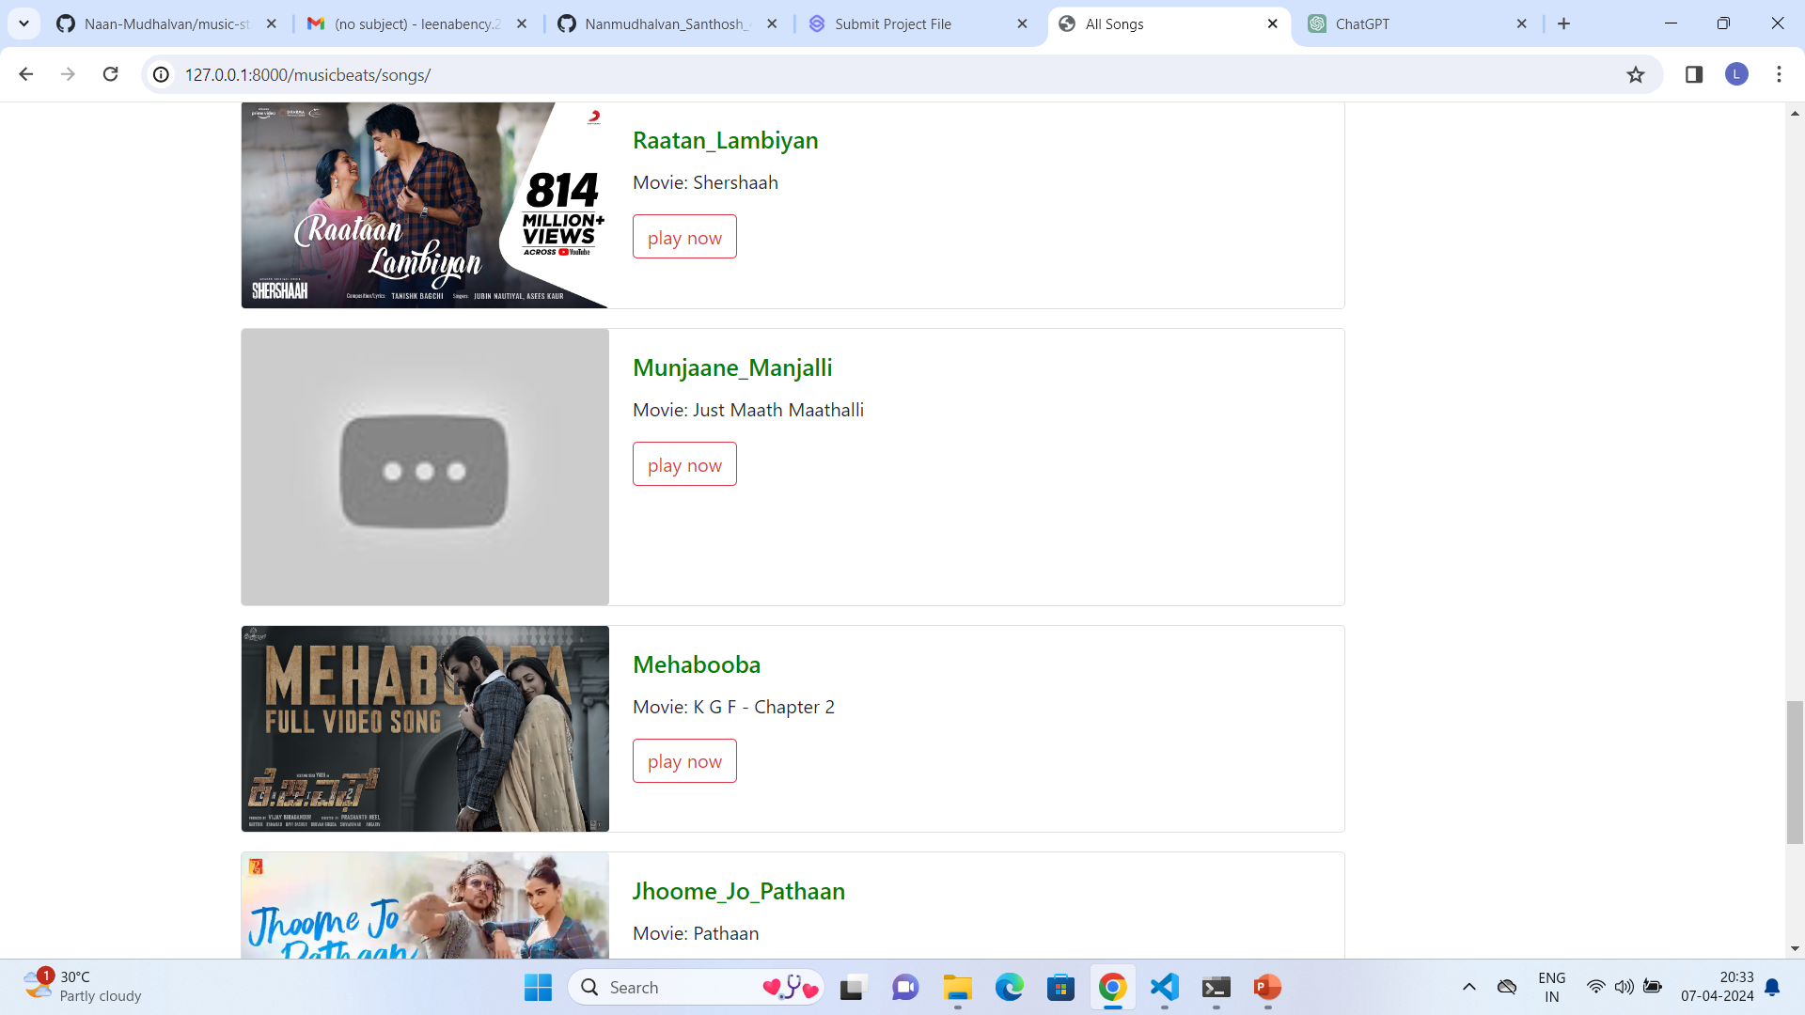

Slide 18
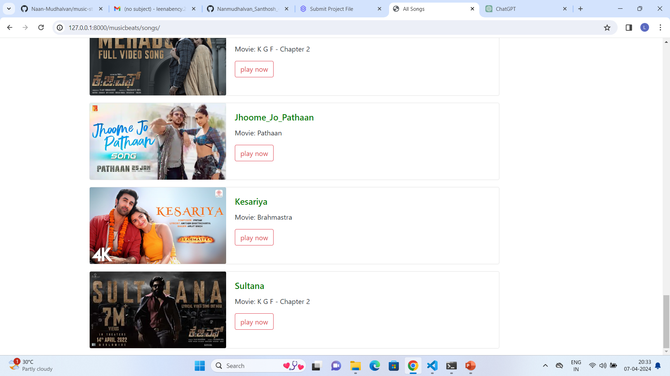

Slide 19
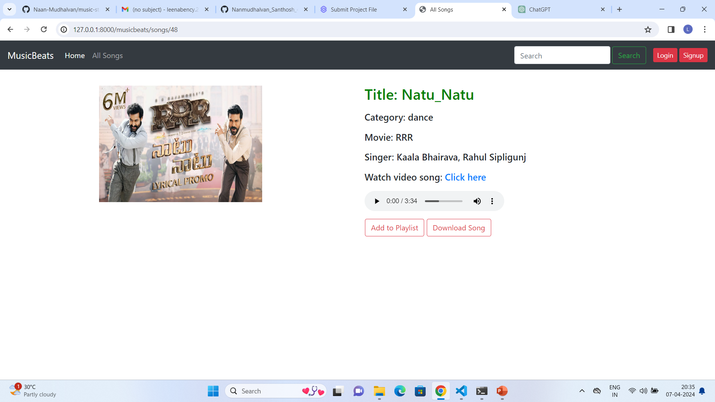
Play Now Page

Slide 20
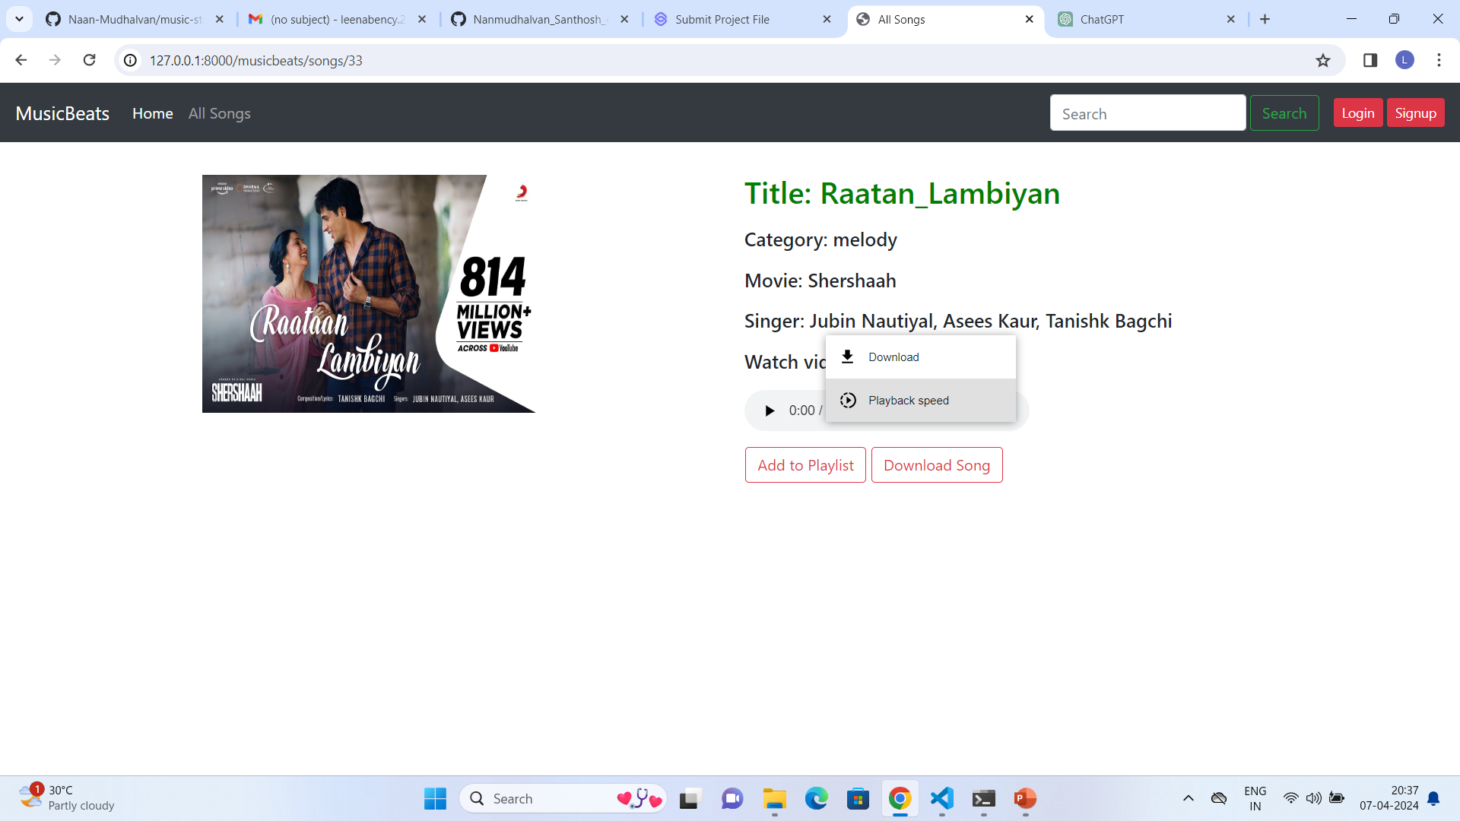

Slide 21
Future Enhancements:
Social Integration
Enhanced Recommendation System
Advanced Playlist Features
Offline Mode
Music Analysis and Insights
Customizable User Profiles
Live Streaming and Events
Cross-Platform Compatibility
Localized Content and Language Support
Accessibility Features
These enhancements aim to enrich MusicBeats' user experience, expand its functionality, and ensure accessibility and inclusivity for all users.

Slide 22
Conclusion
MusicBeats offers users a seamless and personalized music experience through secure authentication, intuitive playlist management, and advanced recommendation algorithms.
Leveraging Django's backend capabilities and dynamic frontend interface, it redefines music consumption in the digital age.
With potential future enhancements, MusicBeats aims to continually innovate and enrich the music exploration journey for users worldwide.
Source :

Slide 23
Thank You!
Notes:
Thank You !!

